Slide 1
Logical Agents

Slide 2
LOGICAL AGENTS
Knowledge-based agents – agents that have an explicit representation of knowledge that can be reasoned with.
These agents can manipulate knowledge to infer new things at the “knowledge level”

Slide 3
OUTLINE
Knowledge-based agents
Wumpus world
Logic in general - models and entailment
Propositional (Boolean) logic
Equivalence, validity, satisfiability
Inference rules and theorem proving
  forward chaining
  backward chaining
  resolution

Slide 4
LOGICAL AGENTS
Humans can know “things” and “reason”
  Representation: How are the things stored?
  Reasoning: How is the knowledge used?
    To solve a problem…
    To generate more knowledge…
Knowledge and reasoning are important to artificial agents because they enable successful behaviors difficult to achieve otherwise
  Useful in partially observable environments
Can benefit from knowledge in very general forms, combining and recombining information

Slide 5
KNOWLEDGE-BASED AGENTS
Central component of a Knowledge-Based Agent is a Knowledge-Base
  A set of sentences in a formal language
    Sentences are expressed using a knowledge representation language
Two generic functions:
  TELL - add new sentences (facts) to the KB
    “Tell it what it needs to know”
  ASK - query what is known from the KB
    “Ask what to do next”

Slide 6

KNOWLEDGE BASES
Knowledge base = set of sentences in a formal language
Declarative approach to building an agent (or other system):
  Tell it what it needs to know
Then it can Ask itself what to do - answers should follow from the KB
Agents can be viewed
  at the knowledge level - i.e., what they know, regardless of how implemented
  Or at the implementation level
  i.e., data structures in KB and algorithms that manipulate them

Slide 7
KNOWLEDGE-BASED AGENTS
The agent must be able to:
  Represent states and actions
  Incorporate new percepts
  Update internal representations of the world
  Deduce hidden properties of the world
  Deduce appropriate actions
Declarative
  You can build a knowledge-based agent simply by “TELLing” it what it needs to know
Procedural
  Encode desired behaviors directly as program code
  Minimizing the role of explicit representation and reasoning can result in a much more efficient system

Slide 8

A SIMPLE KNOWLEDGE-BASED AGENT
The agent must be able to:
  Represent states, actions, etc.
  Incorporate new percepts
  Update internal representations of the world
  Deduce hidden properties of the world
  Deduce appropriate actions
Notes:
KB agent maintains a knowledge base which may initially contain background information. Each time the program is called, it (1) tells the KB what it perceives, (2) it asks the knowledge base what it should do, (3) it tells the KB what it does and time moves on…

Slide 9
A WUMPUS WORLD
The Wumpus world is a cave which has 4/4 rooms connected with passageways. So there are total 16 rooms which are connected with each other. We have a knowledge-based agent who will go forward in this world. The cave has a room with a beast which is called Wumpus, who eats anyone who enters the room. The Wumpus can be shot by the agent, but the agent has a single arrow. In the Wumpus world, there are some Pits rooms which are bottomless, and if agent falls in Pits, then he will be stuck there forever. The exciting thing with this cave is that in one room there is a possibility of finding a heap of gold. So the agent goal is to find the gold and climb out the cave without fallen into Pits or eaten by Wumpus. The agent will get a reward if he comes out with gold, and he will get a penalty if eaten by Wumpus or falls in the pit.

Slide 10

A WUMPUS WORLD
Notes:
To get an idea of what a KB agent can do, let’s consider the Wumpus World.
A cave consisting of rooms connected by passageways. Lurking somewhere is a wumpus – a beast who eats anyone who enters the room. The wumpus stinks (and you can smell him a room away). Some rooms contain bottomless pits that will trap anyone who wanders in (there is a breeze in rooms next to the pit). The goal is to reach the gold (you know it is in the room because it glitters).

Slide 11
WUMPUS WORLD PEAS DESCRIPTION
Performance measure
  gold +1000, death -1000
  -1 per step, -10 for using the arrow
Environment: 4 x 4 grid of rooms
  Squares adjacent to wumpus are smelly
  Squares adjacent to pit are breezy
  Glitter iff gold is in the same square
  Shooting kills wumpus if you are facing it
  Shooting uses up the only arrow
  Grabbing picks up gold if in same square
  Releasing drops the gold in same square
Sensors: Stench, Breeze, Glitter, Bump, Scream (shot Wumpus)
Actuators: Left turn, Right turn, Forward, Grab, Release, Shoot
Notes:
Agent always starts in square [1,1] facing right. Locations of the gold and the wumpus are chosen randomly (from squares other than the start square)

Slide 12
WUMPUS WORLD CHARACTERIZATION
Fully Observable
Deterministic
Episodic
Static
Discrete
Single-agent?
Notes:
Fully Observable – does sensors give access to full state of the environment?

Slide 13
WUMPUS WORLD CHARACTERIZATION
Fully Observable No – only local perception
Deterministic
Episodic
Static
Discrete
Single-agent?
Notes:
Deterministic – is the next state completely determined by the current state and the action executed by the agent or is there some uncertaintity?

Slide 14
WUMPUS WORLD CHARACTERIZATION
Fully Observable No – only local perception
Deterministic Yes – outcomes exactly specified
Episodic
Static
Discrete
Single-agent?
Notes:
Episodic (or sequential) – episodic means divided into independent atomic episodes (like an assembly line robot where decisions about the current part does not affect the decision on the next part) or Sequential – where current action affects future environments.

Slide 15
WUMPUS WORLD CHARACTERIZATION
Fully Observable No – only local perception
Deterministic Yes – outcomes exactly specified
Episodic No – sequential at the level of actions
Static
Discrete
Single-agent?
Notes:
Static or dynamic? Does the world change as time goes by?

Slide 16
WUMPUS WORLD CHARACTERIZATION
Fully Observable No – only local perception
Deterministic Yes – outcomes exactly specified
Episodic No – sequential at the level of actions
Static Yes – Wumpus and Pits do not move
Discrete
Single-agent?
Notes:
Discrete versus continuous

Slide 17
WUMPUS WORLD CHARACTERIZATION
Fully Observable No – only local perception
Deterministic Yes – outcomes exactly specified
Episodic No – sequential at the level of actions
Static Yes – Wumpus and Pits do not move
Discrete Yes
Single-agent?
Notes:
Vs multi-agent?

Slide 18
WUMPUS WORLD CHARACTERIZATION
Fully Observable No – only local perception
Deterministic Yes – outcomes exactly specified
Episodic No – sequential at the level of actions
Static Yes – Wumpus and Pits do not move
Discrete Yes
Single-agent? Yes – Wumpus is essentially a natural feature

Slide 19
WUMPUS WORLD
Percepts given to the agent
Stench
Breeze
Glitter
Bumb (ran into a wall)
Scream (wumpus has been hit by arrow)
Principle Difficulty: agent is initially ignorant of the configuration of the environment – going to have to reason to figure out where the gold is without getting killed!
Notes:
Agent always starts in square [1,1] facing right. Locations of the gold and the wumpus are chosen randomly (from squares other than the start square).
Note the agent perceives the environment - percept looks like
[stench, breeze, glitter, bump, scream]
Let’s see how the knowledge-based agent would explore the world – trying to learn whether or not it can locate the gold without getting killed.

Slide 20
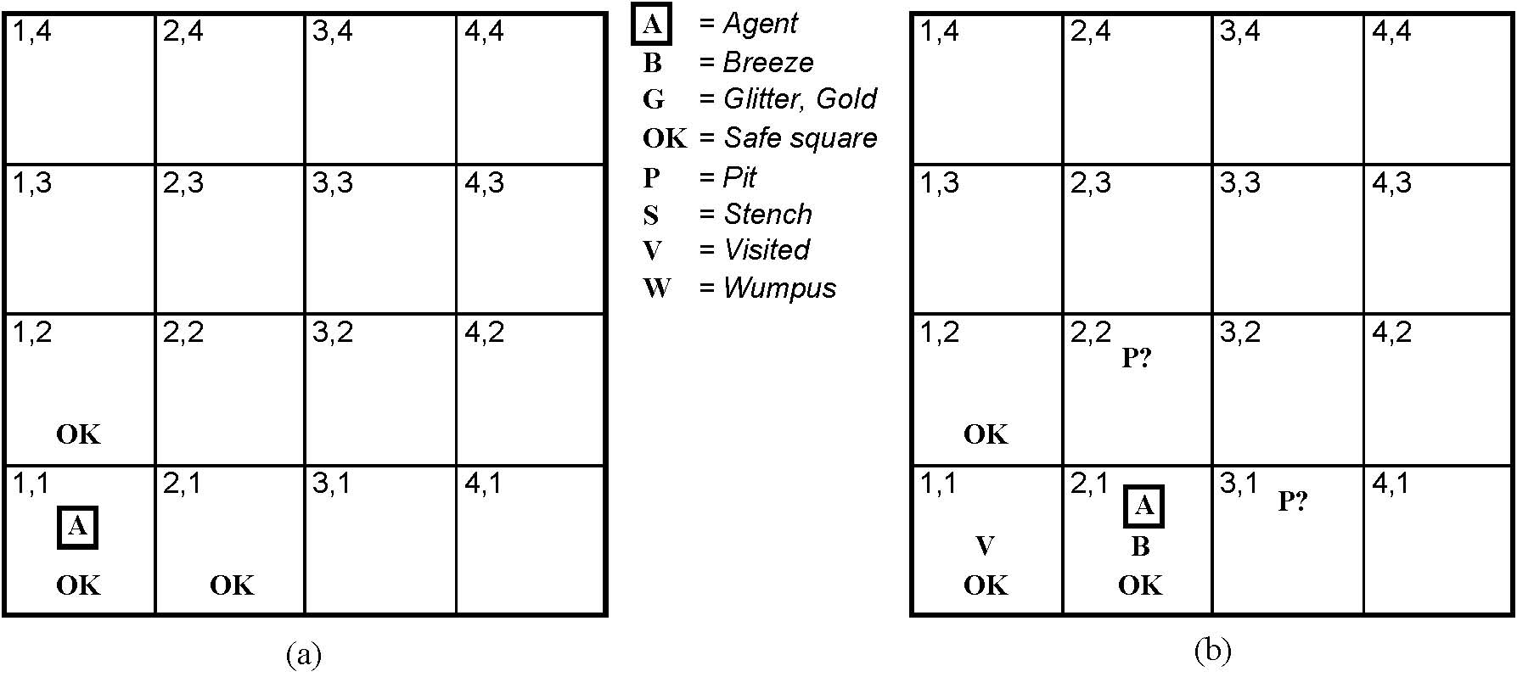
EXPLORING THE WUMPUS WORLD
Initial situation:
Agent in 1,1 and percept is
[None, None, None, None, None]
From this the agent can infer the neighboring squares are safe (otherwise there would be a breeze or a stench)
Notes:
We will mark down what we know – initially the agent (A) is in 1,1, and we know that that square is OK.
It then gets the first percept – remember order is
[stench, breeze, glitter, bump, scream] – and first percept has these all null.
A cautious agent will move only into a square it knows to be OK.

Slide 21

EXPLORING A WUMPUS WORLD
Notes:
In initial state, there are no percepts (the sequence is none, none, none, none, none) and therefore it can be inferred that the neighboring squares are safe (OK).

Slide 22

EXPLORING A WUMPUS WORLD
Notes:
The agent decides to move up and feels a breeze – what does this mean?

Slide 23

EXPLORING A WUMPUS WORLD
Notes:
That there is a pit in either of the two neighboring squares. Better not move there since it knows there is a safer move if it backs up…

Slide 24

EXPLORING A WUMPUS WORLD
Notes:
So it does – and what can it infer from there?

Slide 25

EXPLORING A WUMPUS WORLD
Notes:
A pretty difficult inference!; note how difficult because of the inference of where the pit is depends on the lack of a percept (no B in 2,1) and percepts gathered over time.

Slide 26

EXPLORING A WUMPUS WORLD

Slide 27

EXPLORING A WUMPUS WORLD

Slide 28

EXPLORING A WUMPUS WORLD
Notes:
The agent wins!

Slide 29
EXPLORING A WUMPUS WORLD
In each case where the agent draws a conclusion from the available
Information, that conclusion is guaranteed to be correct if the available
Information is correct…
This is a fundamental property of logical reasoning
Notes:
The agent wins!

Slide 30
LOGIC IN GENERAL
Logics are formal languages for representing information such that conclusions can be drawn
Syntax defines how symbos can be put together to form the sentences in the language
Semantics define the "meaning" of sentences;
  i.e., define truth of a sentence in a world (given an interpretation)
E.g., the language of arithmetic
  x+2 ≥ y is a sentence; x2+y > {} is not a sentence
  x+2 ≥ y is true iff the number x+2 is no less than the number y
  x+2 ≥ y is true in a world where x = 7, y = 1
  x+2 ≥ y is false in a world where x = 0, y = 6
Notes:
Let’s see how we can do that kind of reasoning.
In order to have a logic, we need to have a couple of things…
In standard logics, every sentence must be either true or false in each possible world – there is no in between.

Slide 31
ENTAILMENT
Entailment means that one thing follows logically from another:
KB ╞ α
Knowledge base KB entails sentence α if and only if α is true in all worlds where KB is true
  E.g., x+y = 4 entails 4 = x+y
  Entailment is a relationship between sentences (i.e., syntax) that is based on semantics
Notes:
Here you want to see a possible world as a mapping of the sentences into t or f in the possible world.

Slide 32

MODELS
Logicians typically think in terms of models, which are formally structured worlds with respect to which truth can be evaluated
We say m is a model of a sentence α if α is true in m
M(α) is the set of all models of α
Then KB ╞ α iff M(KB) ⊆ M(α)

Slide 33

ENTAILMENT IN THE WUMPUS WORLD
Situation after detecting nothing in [1,1], moving right, breeze in [2,1]
Consider possible models for KB assuming only pits
3 Boolean choices ⇒ 8 possible models
Notes:
The percepts and the agent’s knowledge of the rules of the game (from the PEAS description) constitute the KB. The agent wants to know if the adjacent squares contain pits. Each may or may not contain a pit – so

Slide 34

WUMPUS POSSIBLE MODELS
Notes:
Although the figure shows possible wumpus worlds, they are really nothing more than assignments of true and false to the sentences “there is a pit in …” [1,2], [2,2], [3,1]

Slide 35

WUMPUS MODELS
KB = wumpus-world rules + observations
Notes:
The KB is false in models that contradict what the agent knows – there are just 3 models in which the KB is true. Go through and recognize why… both the true and the false cases.
e.g., KB is false in any models in which [1,2] contains a pit, because there is no breeze in [1,1]

Slide 36

WUMPUS MODELS
KB = wumpus-world rules + observations
α₁ = “there is no pit in [1,2]", KB ╞ α₁, proved by model checking
Notes:
Model checking – enumerate all possible models, and check to see that alpha is true in all models in which KB is true (and then it must be the case that the KB entails alpha).

Slide 37
WUMPUS MODELS
KB = wumpus-world rules + observations

Slide 38

WUMPUS MODELS
KB = wumpus-world rules + observations
α₂ = “there is no pit in [2,2]", KB ╞ α₂

Slide 39
INFERENCE AND ENTAILMENT
Inference is a procedure that allows new sentences to be derived from a knowledge base.
Understanding inference and entailment: think of
  Set of all consequences of a KB as a haystack
  α as the needle
Entailment is like the needle being in the haystack
Inference is like finding it
Notes:
So, these examples not only show entailment, but also how entailment can be used to derive conclusions.

Slide 40
INFERENCE
KB ├_{i} α = sentence α can be derived from KB by inference procedure I
Soundness: i is sound if whenever KB ├_{i} α, it is also true that KB╞ α
Completeness: i is complete if whenever KB╞ α, it is also true that KB ├_{i} α
Preview: we will define a logic (first-order logic) which is expressive enough to say almost anything of interest, and for which there exists a sound and complete inference procedure.
That is, the procedure will answer any question whose answer follows from what is known by the KB.
Notes:
If an inference algorithm I can derive α from knowledge base KB.
An inference algorithm that derives only entailed sentences is called Sound or Truth Preserving.
Completeness- An inference algorithm is complete if it can derive any sentence that is entailed.

Slide 41
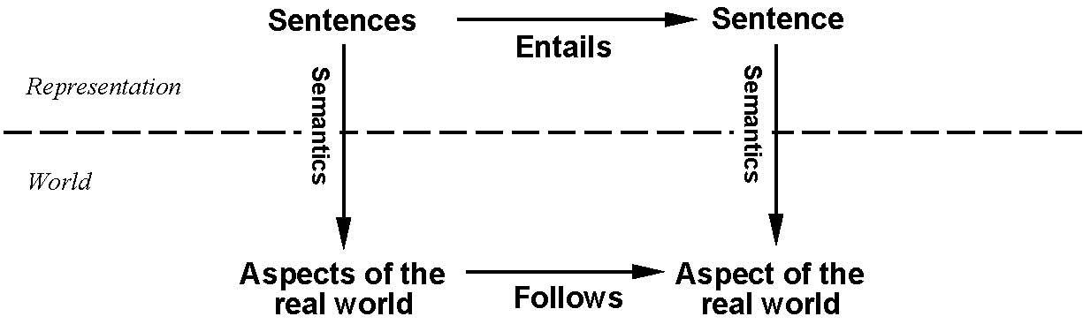
STEP BACK…
This is an inference procedure whose conclusions are guaranteed to be true
In any world where the premises are true.
If KB is true in the real world, then any sentence α derived
from KB by a sound inference procedure is also true in
the real world.
Notes:
We have described an inference procedure whose conclusions are guaranteed to be true in any world in which the premises are true.
Note – the inference procedure operates on syntax – and we can conclude things about the semantics of other sentences in the real world – a very powerful thing.

Slide 42
PROPOSITIONAL LOGIC: SYNTAX
Propositional logic is the simplest logic – illustrates basic ideas
The proposition symbols P₁, P₂ etc are (atomic) sentences
  If S is a sentence, ¬(S) is a sentence (negation)
  If S₁ and S₂ are sentences, (S₁ ∧ S₂) is a sentence (conjunction)
  If S₁ and S₂ are sentences, (S₁ ∨ S₂) is a sentence (disjunction)
  If S₁ and S₂ are sentences, (S₁ ⇒ S₂) is a sentence (implication)
  If S₁ and S₂ are sentences, (S₁ ⇔ S₂) is a sentence (biconditional)
Notes:
Let’s show a simple but powerful logic – called propositional logic. In defining a logic we need to specify its syntax and its semantics – and then we can look at entailment.
Syntax defines allowable sentences. Atomic sentences (propositions) are the smallest bit of thing that one could be “true” or “false”. T and F (true and false) are propositional sentences. From these we use connectives to build up more complicated sentences… I have shown the () here, but they can be dropped w/o loss of generality if we define a precedence order on the operators with not having the highest precedence. Notice the recursive definition.

Slide 43
PROPOSITIONAL LOGIC: SEMANTICS
Each model specifies true/false for each proposition symbol
  E.g. P_{1,2} P_{2,2} P_{3,1}
  false true false
With these symbols, 8 possible models, can be enumerated automatically.
Rules for evaluating truth with respect to a model m:
¬S is true iff S is false
S₁ ∧ S₂ is true iff S₁ is true and S₂ is true
S₁ ∨ S₂ is true iff S₁is true or S₂ is true
S₁ ⇒ S₂ is true iff S₁ is false or S₂ is true
i.e., is false iff S₁ is true and S₂ is false
S₁ ⇔ S₂ is true iff S₁⇒S₂ is true and S₂⇒S₁ is true
Simple recursive process evaluates an arbitrary sentence, e.g.,
¬P_{1,2} ∧ (P_{2,2} ∨ P_{3,1}) = true ∧ (true ∨ false) = true ∧ true = true
Notes:
The semantics defines the rules for determining the truth of a sentence with respect to a particular model – a mapping of the atomic symbols into true and false. The semantics of a logic must say how to compute the truth value of any sentence, given a model.
This is done recursively – by specifying how to compute the semantics of sentences using the 5 connectives.

Slide 44

TRUTH TABLES FOR CONNECTIVES
Notes:
Using the tables, we can compute the truth value of a complex sentence recursively (as we saw on the previous slide).

Slide 45
TRUTH TABLES FOR CONNECTIVES
John likes football and John likes baseball.
John likes football or John likes baseball.
(English or is a bit different…)
Notes:
Notice some intuitions with respect to corresponding English sentences:

Slide 46
TRUTH TABLES FOR CONNECTIVES
John likes football and John likes baseball.
John likes football or John likes baseball.
If John likes football then John likes baseball.
(Note different from English – if John likes football maps to false, then the sentence is true.)
(Implication seems to be if antecedent is true then I claim the consequence is, otherwise I make no claim.)
Notes:
Notice some intuitions with respect to corresponding English sentences:

Slide 47
WUMPUS WORLD SENTENCES
Let P_{i,j} be true if there is a pit in [i, j].
Let B_{i,j} be true if there is a breeze in [i, j].
  ¬ P_{1,1}
  ¬B_{1,1}
  B_{2,1}
"Pits cause breezes in adjacent squares“
B_{2,1} ⇔ (P_{1,1} ∨ P_{2,2} ∨ P_{3,1})
B1,1  (P1,2  P2,1)

Slide 48
SIMPLE INFERENCE PROCEDURE
KB╞ α?
Model checking – enumerate the models, and check if α is true in every model in which KB is true. Size of truth table depends on # of atomic symbols.
Remember – a model is a mapping of all atomic symbols to true or false – use semantics of connectives to come to an interpretation for them.

Slide 49
WUMPUS WORLD SENTENCES
Let P_{i,j} be True if there is a pit in [i,j]
Let B_{i,j} be True if there is a breeze in [i,j]
  ¬P_{1,1}
  ¬ B_{1,1}
  B_{2,1}
“Pits cause breezes in adjacent squares”
  B_{1,1} ⇔ (P_{1,2} ∨ P_{2,1})
  B_{2,1} ⇔ (P_{1,1} ∨ P_{2,2} ∨ P_{3,1})
A square is breezy if and only if there is an adjacent pit

Slide 50
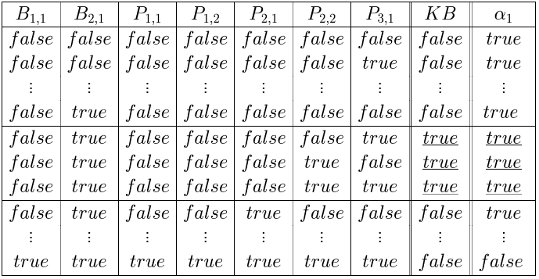
A SIMPLE KNOWLEDGE BASE
R1: ¬P_{1,1}
R2: B_{1,1} ⇔ (P_{1,2} ∨ P_{2,1})
R3: B_{2,1} ⇔ (P_{1,1} ∨ P_{2,2} ∨ P_{3,1})
R4: ¬ B_{1,1}
R5: B_{2,1}
KB consists of sentences R₁ thru R₅
R1 ∧ R2 ∧ R3 ∧ R4 ∧ R5

Slide 51

INFERENCE BY ENUMERATION
Depth-first enumeration of all models is sound and complete
For n symbols, time complexity is O(2^{n}), space complexity is O(n)

Slide 52

LOGICAL EQUIVALENCE
Two sentences are logically equivalent iff true in same models: α ≡ ß iff α╞ β and β╞ α

Slide 53
VALIDITY AND SATISFIABILITY
A sentence is valid if it is true in all models,
  e.g., True, A ∨¬A, A ⇒ A
Validity is connected to inference via the Deduction Theorem:
  KB ╞ α if and only if (KB ⇒ α) is valid
A sentence is satisfiable if it is true in some model.
A sentence is unsatisfiable if it is true in no models
  e.g., A∧¬A
Satisfiability is connected to inference via the following:
  KB ╞ α if and only if (KB ∧¬α) is unsatisfiable

Slide 54
REASONING PATTERNS
Inference Rules
  Patterns of inference that can be applied to derive chains of conclusions that lead to the desired goal.
Modus Ponens
  Given: S1 ⇒ S2 and S1, derive S2
And-Elimination
  Given: S1 ∧ S2, derive S1
  Given: S1 ∧ S2, derive S2
DeMorgan’s Law
  Given: ¬( A ∨ B) derive ¬A ∧ ¬B
  Given: ¬( A ∧ B) derive ¬A ∨ ¬B

Slide 55
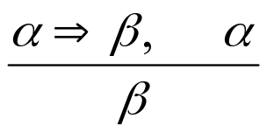
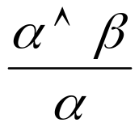
REASONING PATTERNS
Modus Ponens
Whenever sentences of the form α ⇒ β and α are given, then sentence β can be inferred
  (WumpusAhead ∧ WumpusAlive) ⇒ Shoot and (WumpusAhead ∧ WumpusAlive), Shoot can be inferred
And Elimination
From a conjunction, any of the conjuncts can be inferred
  (WumpusAhead ∧ WumpusAlive), WumpusAlive can be inferred

Slide 56
EXAMPLE PROOF BY DEDUCTION
Knowledge
  S1: B₂₂ ⇔ ( P₂₁ ∨ P₂₃ ∨ P₁₂ ∨ P₃₂ ) rule
  S2: ¬B₂₂ observation
Inferences
  S3: (B₂₂ ⇒ (P₂₁ ∨ P₂₃ ∨ P₁₂ ∨ P₃₂ ))∧
  ((P₂₁ ∨ P₂₃ ∨ P₁₂ ∨ P₃₂ ) ⇒ B₂₂) [S1,bi elim]
  S4: ((P₂₁ ∨ P₂₃ ∨ P₁₂ ∨ P₃₂ ) ⇒ B₂₂) [S3, and elim]
  S5: (¬B₂₂ ⇒ ¬( P₂₁ ∨ P₂₃ ∨ P₁₂ ∨ P₃₂ )) [contrapos]
  S6: ¬(P₂₁ ∨ P₂₃ ∨ P₁₂ ∨ P₃₂ ) [S2,S6, MP]
  S7: ¬P₂₁ ∧ ¬P₂₃ ∧ ¬P₁₂ ∧ ¬P₃₂ [S6, DeMorg]

Slide 57
EVALUATION OF DEDUCTIVE INFERENCE
Sound
  Yes, because the inference rules themselves are sound. (This can be proven using a truth table argument).
Complete
  If we allow all possible inference rules, we’re searching in an infinite space, hence not complete
  If we limit inference rules, we run the risk of leaving out the necessary one…
Monotonic
  If we have a proof, adding information to the DB will not invalidate the proof

Slide 58
RESOLUTION
Resolution allows a complete inference mechanism (search-based) using only one rule of inference
Resolution rule:
  Given: P₁ ∨ P₂ ∨ P_{3 …}∨ P_{n,} and ¬P₁ ∨ Q_{1 …}∨ Q_{m}
  Conclude: P₂ ∨ P_{3 …}∨ P_{n} ∨ Q_{1 …}∨ Q_{m}
  Complementary literals P₁ and ¬P₁ “cancel out”
Why it works:
  Consider 2 cases: P₁ is true, and P₁ is false

Slide 59
RESOLUTION IN WUMPUS WORLD
There is a pit at 2,1 or 2,3 or 1,2 or 3,2
  P₂₁ ∨ P₂₃ ∨ P₁₂ ∨ P₃₂
There is no pit at 2,1
  ¬P₂₁
Therefore (by resolution) the pit must be at 2,3 or 1,2 or 3,2
  P₂₃ ∨ P₁₂ ∨ P₃₂

Slide 60
PROOF USING RESOLUTION
To prove a fact P, repeatedly apply resolution until either:
  No new clauses can be added, (KB does not entail P)
  The empty clause is derived (KB does entail P)
This is proof by contradiction: if we prove that KB ∧ ¬P derives a contradiction (empty clause) and we know KB is true, then ¬P must be false, so P must be true!
To apply resolution mechanically, facts need to be in Conjunctive Normal Form (CNF)
To carry out the proof, need a search mechanism that will enumerate all possible resolutions.

Slide 61
CNF EXAMPLE
B₂₂ ⇔ ( P₂₁ ∨ P₂₃ ∨ P₁₂ ∨ P₃₂ )
Eliminate ⇔ , replacing with two implications
  (B₂₂ ⇒ ( P₂₁ ∨ P₂₃ ∨ P₁₂ ∨ P₃₂ )) ∧ ((P₂₁ ∨ P₂₃ ∨ P₁₂ ∨ P₃₂ ) ⇒ B₂₂)
Replace implication (A ⇒ B) by ¬A ∨ B
  (¬B₂₂ ∨ ( P₂₁ ∨ P₂₃ ∨ P₁₂ ∨ P₃₂ )) ∧ (¬(P₂₁ ∨ P₂₃ ∨ P₁₂ ∨ P₃₂ ) ∨ B₂₂)
Move ¬ “inwards” (unnecessary parens removed)
  (¬B₂₂ ∨ P₂₁ ∨ P₂₃ ∨ P₁₂ ∨ P₃₂ ) ∧ ( (¬P₂₁ ∧ ¬P₂₃ ∧ ¬P₁₂ ∧ ¬P₃₂ ) ∨ B₂₂)
4. Distributive Law
  (¬B₂₂ ∨ P₂₁ ∨ P₂₃ ∨ P₁₂ ∨ P₃₂ ) ∧ (¬P₂₁ ∨ B₂₂) ∧ (¬P₂₃ ∨ B₂₂) ∧ (¬P₁₂ ∨ B₂₂) ∧ (¬P₃₂ ∨ B₂₂)
(Final result has 5 clauses)

Slide 62
CONVERSION TO CNF
B_{1,1} ⇔ (P_{1,2} ∨ P_{2,1})
Eliminate ⇔, replacing α ⇔ β with (α ⇒ β)∧(β ⇒ α).
(B_{1,1} ⇒ (P_{1,2} ∨ P_{2,1})) ∧ ((P_{1,2} ∨ P_{2,1}) ⇒ B_{1,1})
2. Eliminate ⇒, replacing α ⇒ β with ¬α∨ β.
3. Move ¬ inwards using de Morgan's rules and double-negation:
  (¬B_{1,1} ∨ P_{1,2} ∨ P_{2,1}) ∧ ((¬P_{1,2} ∨ ¬P_{2,1}) ∨ B_{1,1})
4. Apply distributivity law (∧ over ∨) and flatten:
(➢B1,1  P1,2  P2,1)  (➢P1,2  B1,1)  (➢P2,1  B1,1)
(➢B1,1  P1,2  P2,1)  (➢(P1,2  P2,1)  B1,1)

Slide 63

RESOLUTION EXAMPLE
KB = R₂∧R₄
(B_{1,1} ⇔ (P_{1,2}∨ P_{2,1})) ∧¬ B_{1,1,} α (Prove)= ¬P_{1,2}

Slide 64
RESOLUTION EXAMPLE
(Given B₂₂ and ¬P₂₁ and ¬P₂₃ and ¬P₃₂ , prove P₁₂
  (¬B₂₂ ∨ P₂₁ ∨ P₂₃ ∨ P₁₂ ∨ P₃₂ ) ; ¬P₁₂
  (¬B₂₂ ∨ P₂₁ ∨ P₂₃ ∨ P₃₂ ) ; ¬P₂₁
  (¬B₂₂ ∨ P₂₃ ∨ P₃₂ ) ; ¬P₂₃
  (¬B₂₂ ∨ P₃₂ ) ; ¬P₃₂
  (¬B₂₂) ; B₂₂
  [empty clause]

Slide 65
EVALUATION OF RESOLUTION
Resolution is sound
  Because the resolution rule is true in all cases
Resolution is complete
  Provided a complete search method is used to find the proof, if a proof can be found it will
  Note: you must know what you’re trying to prove in order to prove it!
Resolution is exponential
  The number of clauses that we must search grows exponentially…

Slide 66
HORN CLAUSES
A Horn Clause is a CNF clause with exactly one positive literal
  The positive literal is called the head
  The negative literals are called the body
  Prolog: head:- body1, body2, body3 …
  English: “To prove the head, prove body1, …”
  Implication: If (body1, body2 …) then head
Horn Clauses form the basis of forward and backward chaining
The Prolog language is based on Horn Clauses
Deciding entailment with Horn Clauses is linear in the size of the knowledge base

Slide 67
REASONING WITH HORN CLAUSES
Forward Chaining
  For each new piece of data, generate all new facts, until the desired fact is generated
  Data-directed reasoning
Backward Chaining
  To prove the goal, find a clause that contains the goal as its head, and prove the body recursively
  (Backtrack when you chose the wrong clause)
  Goal-directed reasoning

Slide 68
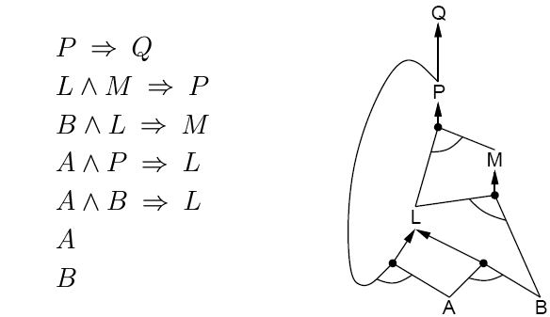
FORWARD CHAINING
Data driven Reasoning
Fire any rule whose premises are satisfied in the KB
Add its conclusion to the KB until the query is found

Slide 69
FORWARD CHAINING
AND-OR Graph
  multiple links joined by an arc indicate conjunction – every link must be proved
  multiple links without an arc indicate disjunction – any link can be proved

Slide 70
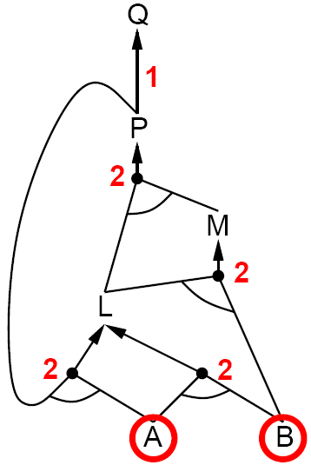
FORWARD CHAINING

Slide 71
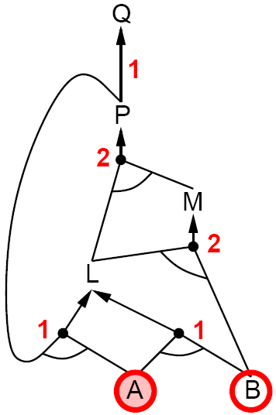
FORWARD CHAINING

Slide 72
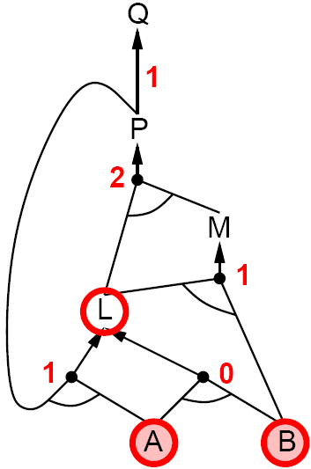
FORWARD CHAINING

Slide 73
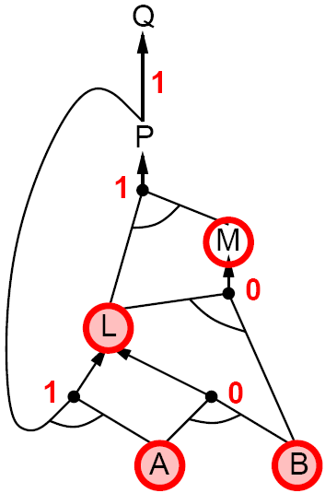
FORWARD CHAINING

Slide 74
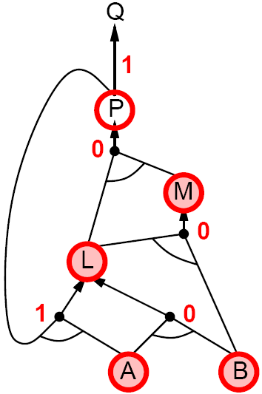
FORWARD CHAINING

Slide 75
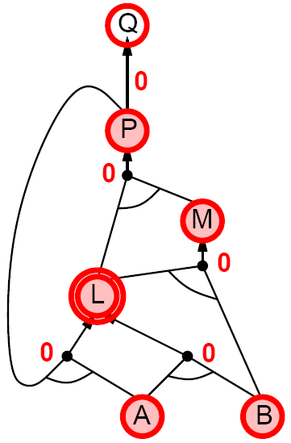
FORWARD CHAINING

Slide 76
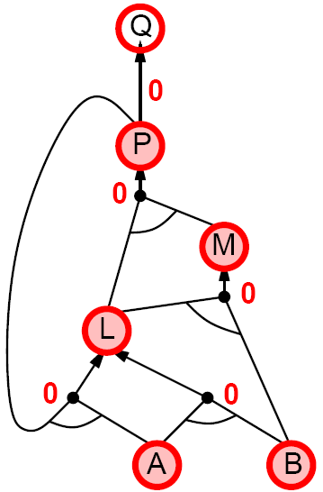
FORWARD CHAINING

Slide 77
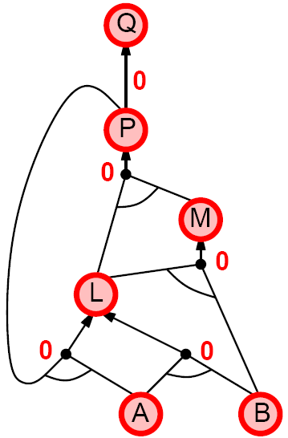
FORWARD CHAINING

Slide 78
BACKWARD CHAINING
Idea: work backwards from the query q:
  To prove q by BC,
    Check if q is known already, or
    Prove by BC all premises of some rule concluding q
Avoid loops
  Check if new subgoal is already on the goal stack
Avoid repeated work: check if new subgoal
  Has already been proved true, or
  Has already failed

Slide 79
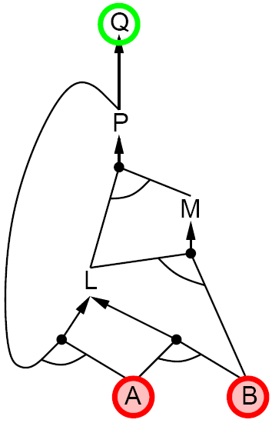
BACKWARD CHAINING

Slide 80
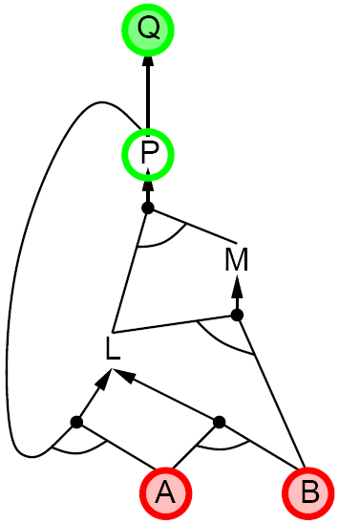
BACKWARD CHAINING

Slide 81
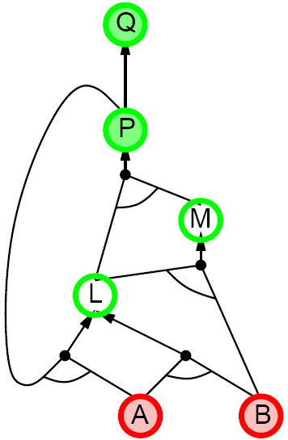
BACKWARD CHAINING

Slide 82
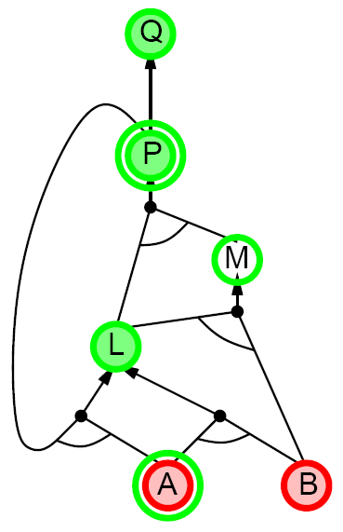
BACKWARD CHAINING

Slide 83
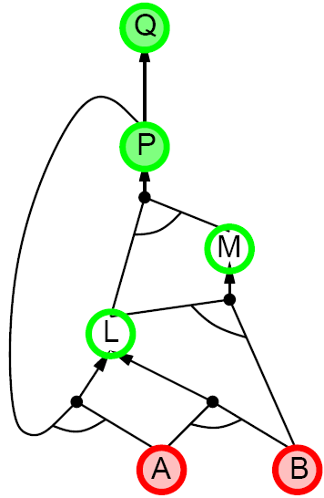
BACKWARD CHAINING

Slide 84
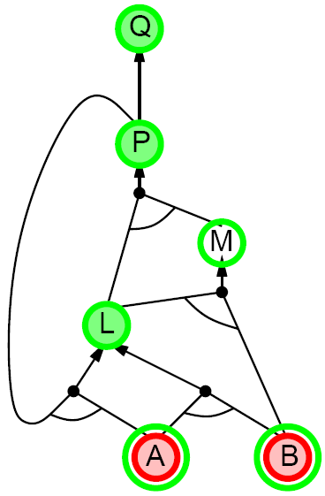
BACKWARD CHAINING

Slide 85
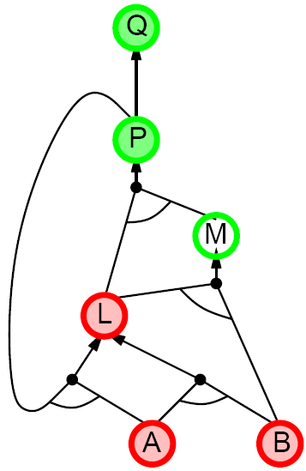
BACKWARD CHAINING

Slide 86
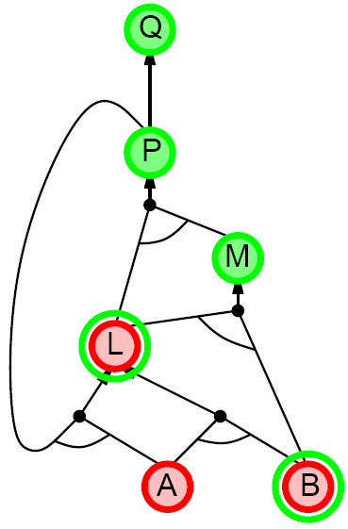
BACKWARD CHAINING

Slide 87
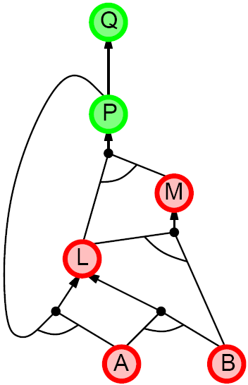
BACKWARD CHAINING

Slide 88
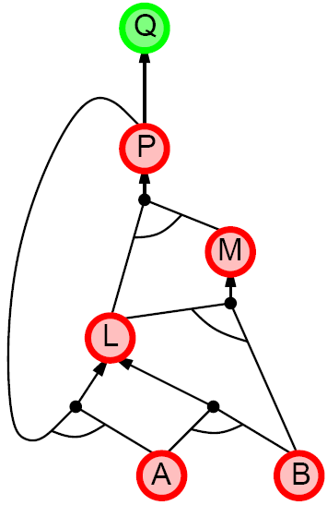
BACKWARD CHAINING

Slide 89
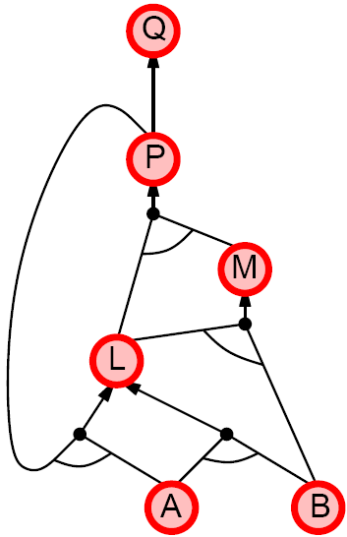
BACKWARD CHAINING

Slide 90
FORWARD CHAINING VS. BACKWARD CHAINING
Forward Chaining is data driven
  Automatic, unconscious processing
  E.g. object recognition, routine decisions
  May do lots of work that is irrelevant to the goal
Backward Chaining is goal driven
  Appropriate for problem solving
The complexity of BC can be much less than linear in size of the KB

